Slide 1
Performing Objects/
Performing Philosophy
Performance Philosophy conference
University of Chicago
April 10-12, 2015
Dr. Carolyn Shapiro, Falmouth University

Slide 2
“Performing Objects”
conference held at Falmouth University, October 17-20, 2013
Puppets; Toy Theatre--<Automata>--Object Oriented Ontology
(human manipulation/subject-object relation)-
<suspension of disbelief; Uncanniness; autonomy”>-Hyperrobjects/unit operations

Slide 3
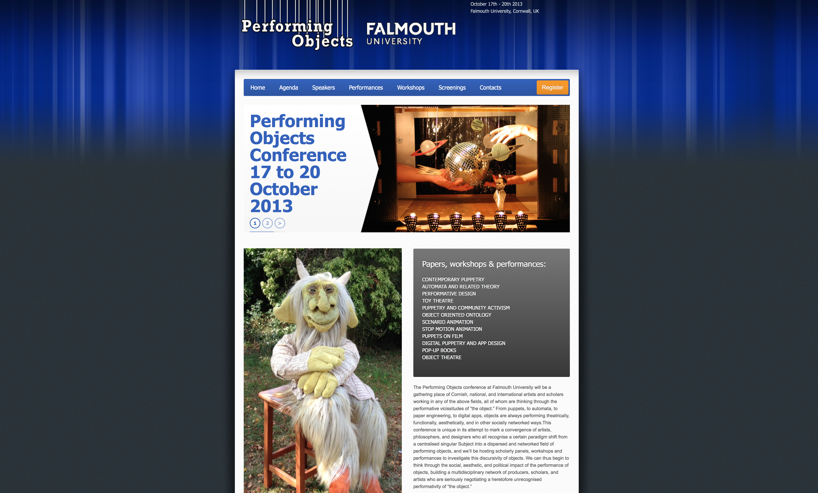
http://performingobjectsconference.co.uk

Slide 4

http://www.falmouthartgallery.com/Collection/Automata_Collection

Slide 5
A philosophical gloss of automaton
(as ambivalent and ironic figure)
To be considered:
Catherine Liu, Copy Machines: Taking Notes for the Automaton, (U. of Minnesota P, 2000)
Liu/Walter Benjamin/Mick Taussig/Mark Sussman, “Theses on the Philosophy of History” ([1950], 1969)
Paul DeMan/J.J. Rousseau, l’effet machinal (Confessions, 1782)
Stupidity (A. Ronell, U. of Illinois P, 2002)
Jeremy Bentham, (Theories of Fiction, 1814-1832)
Jacques Lacan (The Ethics of Psychoanalysis, 1959-60; The Four Fundamental Concepts of Psycho-Analysis, 1973)

Slide 6
“Happiness” and linguistic performativity
J.L. Austin, How to do things with words, (Oxford and Harvard, 1955)
{language as performative, felicitous operation}
H.L.A. Hart: Legal Positivism (Oxford, 1950s)
{is law autonomous of morals?}

Slide 7
Automaton and movement
Aristotle, De Motu Animalium
Jentsch versus Freud on The Uncanny

Slide 8
Object Oriented Ontology
Timothy Morton, Hyperobjects: Philosophy and Ecology after the End of the World (U. of Minnesota P, 2013)
Ian Bogost, Unit Operations: An Approach to Videogame Criticism, The MIT Press, 2006)
inspired by Graham Harman, Tool-Being: Heidegger and the Metaphysics of Objects (Open Court Publishing, 2002)
OOO totally breaks down the relationship between Being and Thinking (a humanist assumption)

Slide 9
“automaton”: highly discursive figure in the 18th century; ambivalent
automata constructed by Vaucanson (mechanical digesting duck, etc. 1730s/40s)
La Mettrie: L’Homme-Machine (1747): “The human body is a self-winding machine, a living representation in perpetual motion.”; Discourse on Happiness (1748) (a materialist view on Happiness)
E.T.A. Hoffman, “The Sandman”– Olympia (1817)
Bentham: the automaton acts as if it had a “mind” of its own; propagates “pestilential fiction”. (late 18th into early 19th century)
anxiety: that humans become automatons: “L’effet machinal” --(Rousseau, Confessions)– (De Manian prototype)

Slide 10
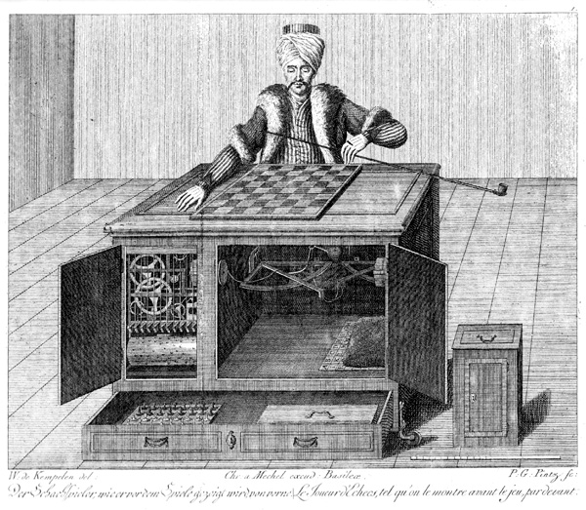
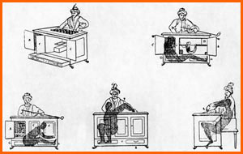
Wolfgang De Kempelin’s automaton Chess-Player
(built 1769, circulated through mid-19th century)
“It was a false automaton which by itself caused more talk than all the others put together, and also acquired a European reputation.” Alfred Chapius and Edmond Droz, Automata: A Historical and Technological Study, 1958, as cited by Catherine Liu.

Slide 11
Walter Benjamin, “Theses on the Philosophy of History”
de Kempelen’s Chess-playing automaton/puppet: has a “philosophical counterpart” in “historical materialism”. (Thesis I)
Historical materialism differs from historicism in that “thinking suddenly stops in a configuration pregnant with tensions… giv[ing] that configuration a shock, by which it crystallizes into a monad.” (Thesis XVII)

Slide 12
Catherine Liu, Copy Machines: Taking Notes for the Automaton, (U. of Minnesota P, 2000)
An indexing of the 18th century automaton as figure of ambivalence
Her starting point: in Walter Benjamin’s “Theses on the Philosophy of History”, the automaton figures critical, deconstructive intervention:
“The historical materialist resists identification… the automaton of historical materialism is crystallized as an image that is not determined by being but, rather, emerges as a flash of insight that disrupts the very temporality of the event. ” (ix-x)

Slide 13
Liu on critical “manipulation” of a text, according to Bénichou:
“The text is a fragile vehicle that transports the ‘signals’ of the author’s will, and not some stupid, empty machine… To follow his arguments to their logical conclusion, however, in order to avoid any kind of ‘manipulation’ of literature, one should simply keep one’s hands to oneself. With the intervention of the hand, the danger of manipulation and abuse arises.” (4-5)

Slide 14
Catherine Liu on the “stupidity” of the automaton
“If detachment can be fascinating, the stupidity of the automaton is also hypnotizing, literally mesmerizing in its idiotic repetition of anthropomorphizing movement. What this hypnosis produces is a nonthinking repudiation or total acceptance. The automaton allegorizes the problem of thinking confronted by nonthinking…” (Liu, xi)

Slide 15
Mark Sussman theorizes the “suspension of disbelief” in the chess-playing automaton:
De Kempelen’s Chess Player: example of “faith-inducing dramaturgy thrown into relief by the trick performance”
The Turkish sorcerer was “conscious (or so it appeared) of the rules of the game” (my emphasis)
“’Tis a deception! Granted, but such a one as does honor to human nature…’” (Sussman citing Windisch [1783]).
(Mark Sussman, “Performing the Intelligent Machine: Deception and Enchantment in the Life of the Automaton Chess Player,” TDR, MIT Press, 2000)

Slide 16
Benjamin’s radical anti-metaphysics (as explained by Sussman):
The Chess Player illustrates “dialectical tension” in that,
“the liveness of the machine was theorized as the power of linear, sequential decision- making, the performance of the art of chess, in which thought itself is performed…” (TDR, 77)

Slide 17
Movement signifies “reality”
“’…the power of moving itself in different directions, as circumstances unforeseen, and depending on the will of any person present’…would be shown as ‘real’ in a series of public performances spanning nearly a century in which both the automaton’s working action and its inner mechanism were revealed.”
(Sussman, 73-74, citing de Windisch [1784])

Slide 18
Jentsch emphasizes doubt in relation to movement as part of the Uncanny– in relation to the automaton (Olympia)
“The mass that at first seemed completely lifeless suddenly reveals an inherent energy because of its movement. This energy can have a psychical or a mechanical origin. As long as the doubt as to the nature of the perceived movement lasts, and with it the obscurity of its cause, a feeling of terror persists in the person concerned.”
(Ernst Jentsch, “On the Psychology of the Uncanny,” 1906)
Freud’s metaphysical blindspot: never picks up on the movement factor– only mentions “animation” as Jentsch’s site of doubt.

Slide 19
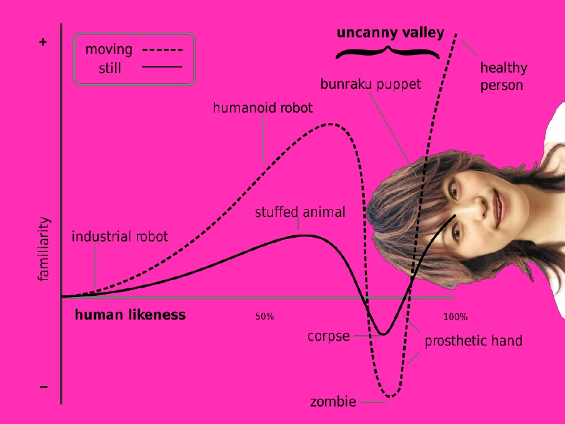
The Uncanny Valley (diagram by Masahiro Mori, 1970, courtesy of Timothy Morton.
“With ecological awareness…everything in your world starts to slip into the uncanny valley, whose sides are infinite and slick. It’s more like an uncanny charnel ground…full of…people…some of whom are humans, some of whom aren’t…” (Hyperobjects, 132)

Slide 20
Aristotle, De Motu Animalium:
“to automaton” describes animal movement, comparable to movement of puppets or “automata”.
the organs of animals correspond to the pegs of a puppet.
Movement of animals determined by the most proximate cause, (animal) desire.
Automata behave as if they bear “final cause” but actually do not.

Slide 21
Joan Copjec reading Aristotle on automaton:
“Automaton, the general category of chance or coincidence, occurs, by contrast [to cause of the Prime-Mover], … as a result of the collision of separate events each with its own independent cause. None of the events occurs because of the other and there is no cause, no connected cause or explanation, for their simultaneity.”
(Read my Desire: Lacan against the Historicists, 1994, 48)

Slide 22
Joan Copjec reading Lacan on automaton:
  “It is this notion of failure [of final cause as explanatory principle] which Lacan will systematically explore, linking it to Aristotle’s general assertion that accidental causes are indeterminate.” (Copjec, 48)

Slide 23
“Tuché and Automaton,” The Four Fundamentals of Psychoanalysis,” [1973] (1981)
Lacan borrows these terms from Aristotle:
Aristotle “uses [tuché] in his search for cause.” (J. Lacan, 53)
{Tuchanein: cognate verb for “happen”}
Tuché: “the real as encounter—the encounter in so far as it may be missed, in so far as it is essentially the missed encounter…” (55) {the awakening knock}
Automaton: “the return, the coming-back, the insistence of the signs, by which we see ourselves governed by the pleasure principle.” (53-54) {unawake, unconscious}

Slide 24
automaton configures primary detachment for Lacan– (the detachment through which the subject performs).
“The subject constructed by language finds itself detached from a part of itself. And it is this primary detachment that renders fruitless all the subject’s efforts for a reunion with its complete being.”
(Joan Copjec, Read My Desire: Lacan Against the Historicists, MIT Press, 1994, 52)

Slide 25
Language, Happiness, and automaton
“It’s odd that in almost all languages happiness offers itself in terms of a meeting —τυχη [Tuche]…A kind of favourable divinity is involved… ‘Happiness’ is after all ‘happen’; it too, is an encounter…”
(Lacan, The Ethics of Psychoanalysis, 13)

Slide 26
Crossovers between Bentham and
J.L. Austin on “happiness”
Bentham’s Felicific Calculus (measures the Greatest Happiness for the Greatest Number): fundamentally performative in its consequential mode of operation.
Law is an exemplary material, potentially “felicitous” entity by virtue of it being fundamentally linguistic.
Both philosophers theorise “happiness” as linguistic operation, in particular, successful operation, in which various conditions have been met. (my emphasis)

Slide 27
Lacan: big fan of Bentham
Bentham is “the man who approaches the question [of the progress of knowledge] at the level of the signifier” (Ethics, 228).
“[For Bentham] ‘Fictitious’ does not mean illusory or deceptive as such…but, in the sense that every truth has the structure of fiction….The fictitious is not, in effect, in its essence that which deceives, but is precisely what I call the symbolic.” (Ethics, 12)

Slide 28
Jeremy Bentham configures language as “automaton”:
“Beholding at a distance, in the dress of a man, sitting and playing upon an organ, an automaton figure, constructed for that purpose by the ingenuity of the mechanist, to take this creature of human art for a real man, is a sort of mistake which, at a certain distance, might happen for a time to be made by the most acute observer, this fictitious entity thus accoutred should present itself in the character of , and be regarded and treated as if it were a real one. How should it be otherwise, when on the very occasion on which, and by every person by whom it is spoken of at all, it is spoken of as if it were a real entity?”
(C.K. Ogden, citing Bentham, xliii)

Slide 29
“l’effet machinal”: language as fiction
  “…a random or mechanical dimension of language exists that cannot be assimilated to a system of intentions, desires, or motives… the random arbitrary functioning of language as ‘fiction’—that is, ‘in the absence of any link between utterance and a referent,… is the functioning of a machine (‘…l’effet machinal de mon embarras’)…”
  ---Cynthia Chase citing Paul de Man citing Rousseau

Slide 30
Ronell on De Man on Rousseau’s l’effet machinal :
“… ‘l’effet machinal’ is responsible for effects of meaning generated by sheer contingency, elements of uncontrol and improvisation. The disjuncture of performance and meaning or intention… has mounted to something of a humanist affront, a scandal.”
(A. Ronell, Stupidity, 98.)

Slide 31
Bentham also links motion to the “automaton” of fiction/language.
“[accounting for]…the motion of such bodies as are in motion, …certain fictitious entities are, by a sort of innocent falsehood, the utterance of which is necessary to the purpose of discourse, feigned to exist and operate in the character of causes…”
(Ogden citing Bentham, xlii)

Slide 32
Object Oriented Ontology: hyperobjects
“Automatic Nothingness”– Keynote title for Performing Objects conference (2013)
Hyperobjects: Philosophy and Ecology after the End of the World (Timothy Morton, 2013)

Slide 33
“hyperobjects”
“…exhibit their effects interobjectively; that is, they can be detected in a space that consists of interrelationships between aesthetic properties of objects.” (Morton, 1)
“The hyperobject is not a function of our knowledge; it’s hyper relative to worms, lemons, and ultraviolet rays, as well as humans.” (2)
“I am scooped out from the inside. My situatedness and the rhetoric of situatedness in this case is not a place of defensive self-certainty but precisely its opposite. That is, situatedness is now a very uncanny place to be… The more we know about hyperobjects, the stranger they become.” (5, 6)
A “disorientation of scale…from slippers to energy flash…” (50)
“As we enter the time of hyperobjects, Nature disappears and all the modern certainties that seemed to accompany it. What remains is a vastly more complex situation that is uncanny and intimate at the same time.” (130)

Slide 34
More OOO: Unit Operations: An Approach to Videogame Criticism (Ian Bogost, 2006)
“Unit operations are modes of meaning-making that privilege discrete, disconnected actions over deterministic, progressive systems.” (3)
“In general, unit operations privilege function over context, instances over longevity.” (4)
“…a unit is a material element, a thing. It can be…like a building block that makes up a system, or it can be autonomous, like a system itself.” (5)
inspired by Graham Harman’s reading of Heidegger’s “readiness-to-hand”, which Harman names “Tool-Being”. (5)

Slide 35
“cellular automata” (Bogost)
term borrowed from physicist Stephen Wolfram to illustrate the logic of unit operations:
“Cellular automata are mechanized systems that perform a single, simple, isolatable task, and then transmit their output to… neighboring… cells [which] perform their own automation, transmit their output, and so forth.” (94)
As applied to playing a simulative videogame: “Playing a simulation means becoming engrossed in a systemic logic which connects a myriad array of causes and effects.” (Bogost, citing Friedman, 102)

Slide 36
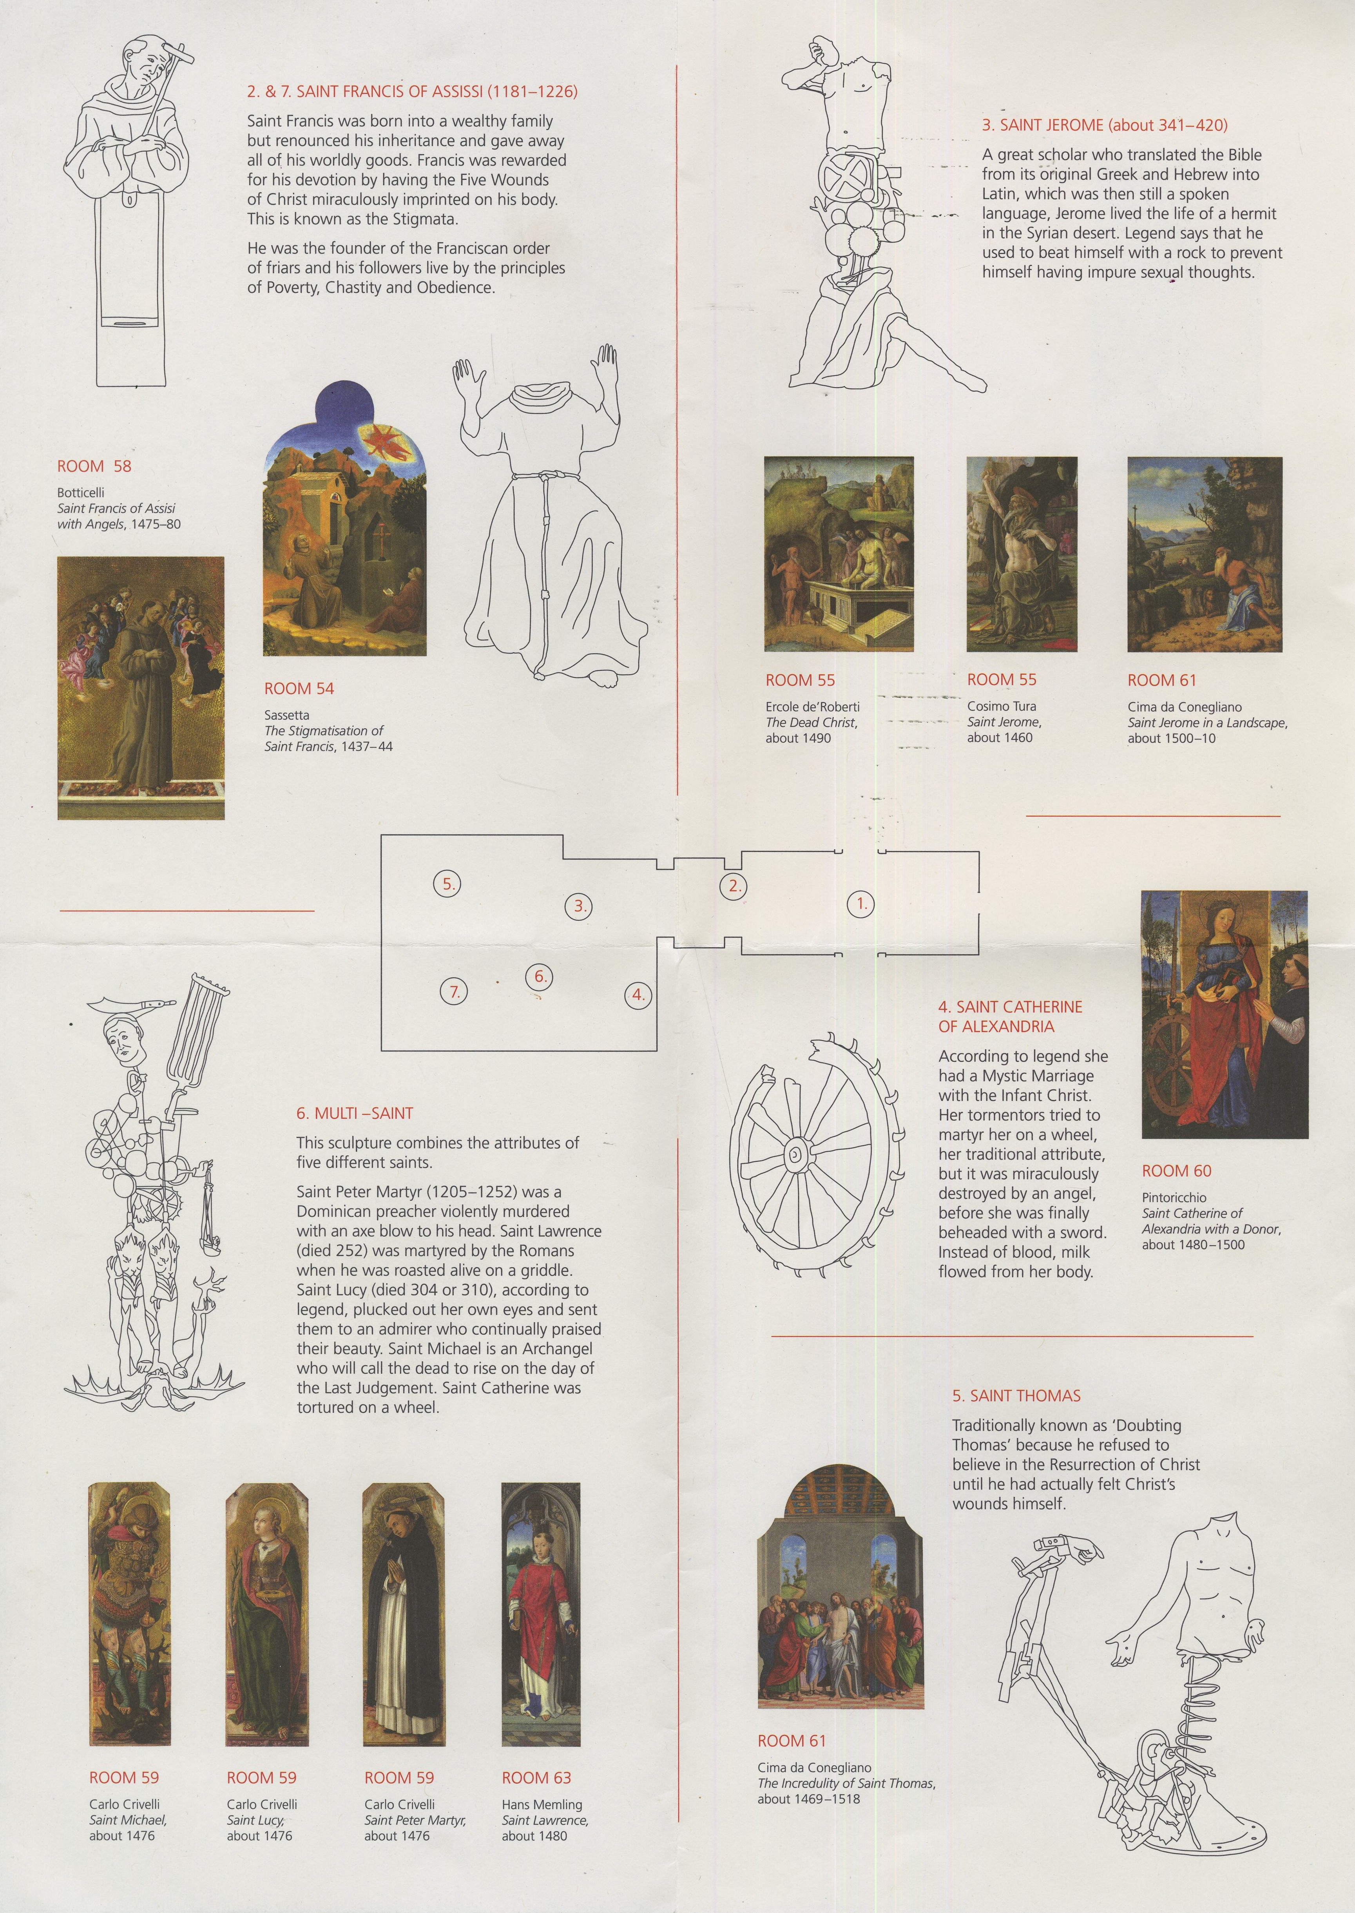
Michael Landy, “Saints Alive,”
National Gallery, London, May-November, 2013

Slide 37
The End
Thank you very much!
Carolyn Shapiro carolyn.shapiro@falmouth.ac.uk

